Slide 1
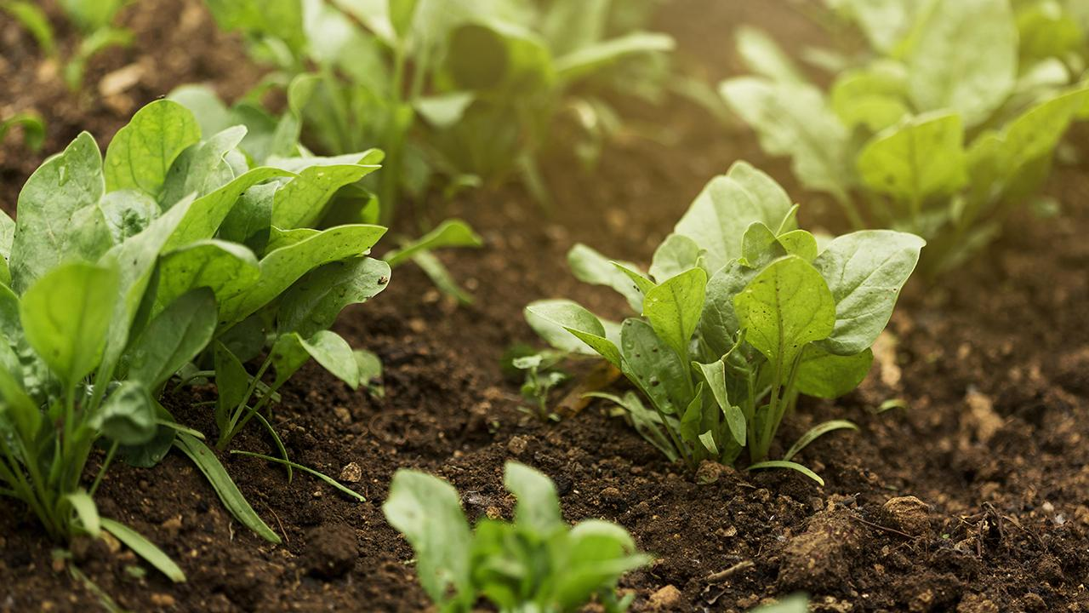
The Effect of Climate change on crops around the world
Hadas Israeli
Inbar Israeli
GitHub

Slide 2

Our research - intro
Research questions:
Does global warming affect agricultural crops?
Will an increase in the level of greenhouse gases affect the amount of agricultural crops in the future?
Can we predict which agricultural crop is most affected by the rise in gas levels? Can we predict who is the least affected?
Can we predict which country is most affected by the rise in gas levels? Can we predict who is the least affected?

Slide 3

Work and Process

Slide 4

Data sources
Crawling
Data Set
State of the Global Climate 2020
FAOStat
Reaserch and information
NASA - Climate Effects on Food Supply:
crop-climate-potential-impacts-world-food-supply crop-climate-effects-climate-global-food-production
Wikipedia
Climate_change_and_agriculture

Slide 5
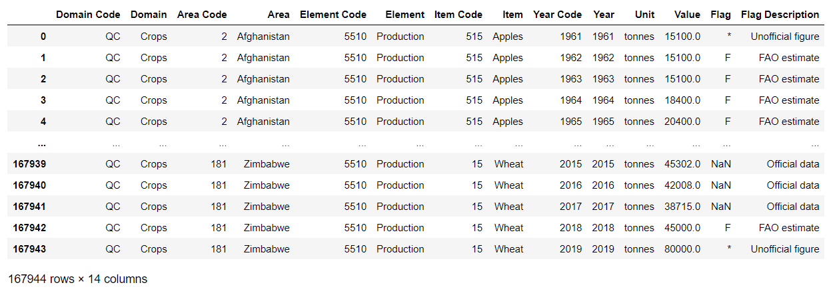
Data Set
The Food and Agriculture Organization (FAO) is a specialized agency of the United Nations that leads international efforts to defeat hunger and has information regarding the agriculture crops growth since 1961. FAO has over 194 member states and works in over 130 countries worldwide.

Slide 6
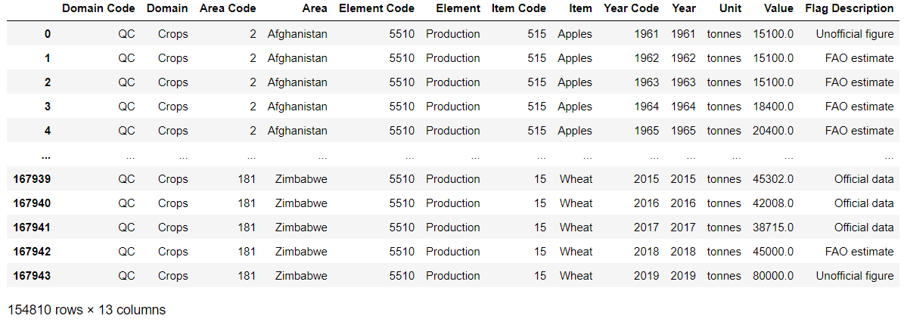
Data Set cleaning
We saved the cleand data set as “data/FAOSTAT_cleaned_data.csv” at the data file of the project
We looked at the Data set with the ‘describe(include='all’)’ & ‘info()’ functions from Pandas library
1
3
We Dropped with 'dropna( axis=0, how='any', subset=[row])' function any missing data from the data set
2

Slide 7
Crawling
Source
Finding the reason and relevant data of climate change
Crawling the charts information from the HTML
”Increasing levels of greenhouse gases in the atmosphere due to human activities are a major driver of climate change”
State of the Global Climate 2020

Slide 8

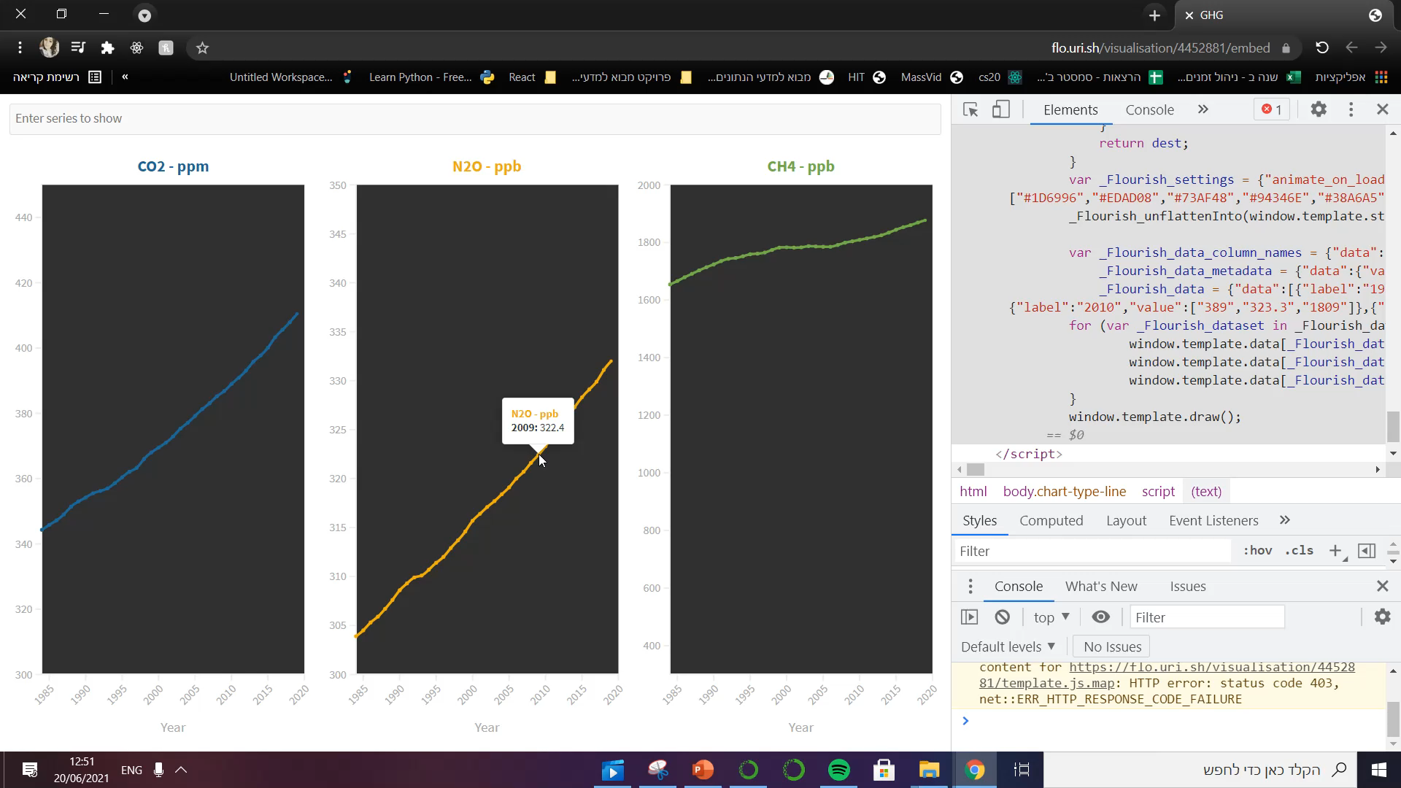
Crawling
The HTML file is dynamic, we found the information in the script tag in the HTML as “_Flourish_data“ We converted the text to csv file

Slide 9
Crawling
1
2
To get the information of the charts from the HTML we used the ‘requests.get(URL)’ and ‘BeautifulSoup(greenhouse_gas_concentrations.text,"html.parser")’ functions.
The information we got using the soup was 'bs4.element.Tag' we convert it to a string. We pulled out the data from flourish_data and put it in a Data frme. We saved the data frame as ‘data/greenhouse gas.csv’ in the data file.

Slide 10
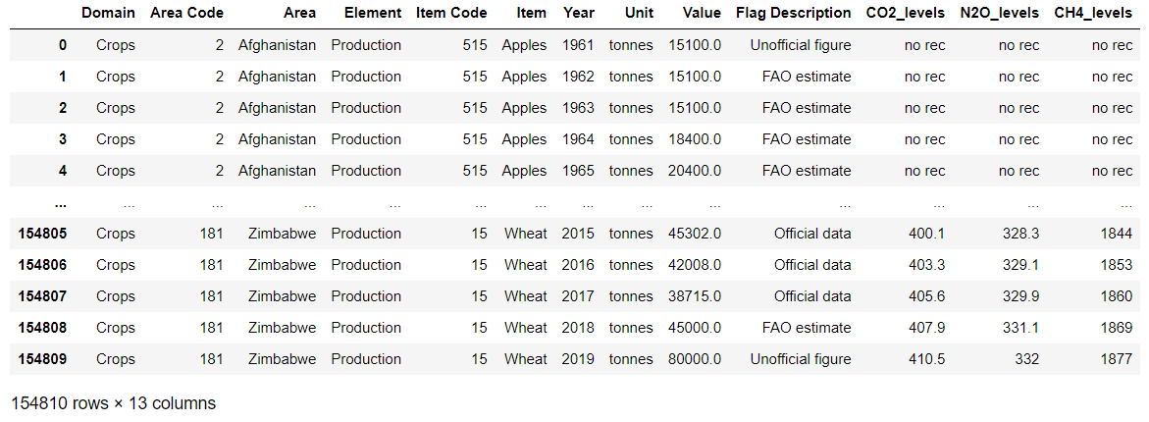
Data merging
FAOSTAT_cleaned_data
greenhouse_gas
The years in the data set were between 1984-2019 so we added ‘no rec’ from 1961-1983
We added the information in the FAOSTAT rows to the greenhouse gas data frame according to years
We saved the merged data frame as ‘data/Gas_Crops_data’ in the data file

Slide 11
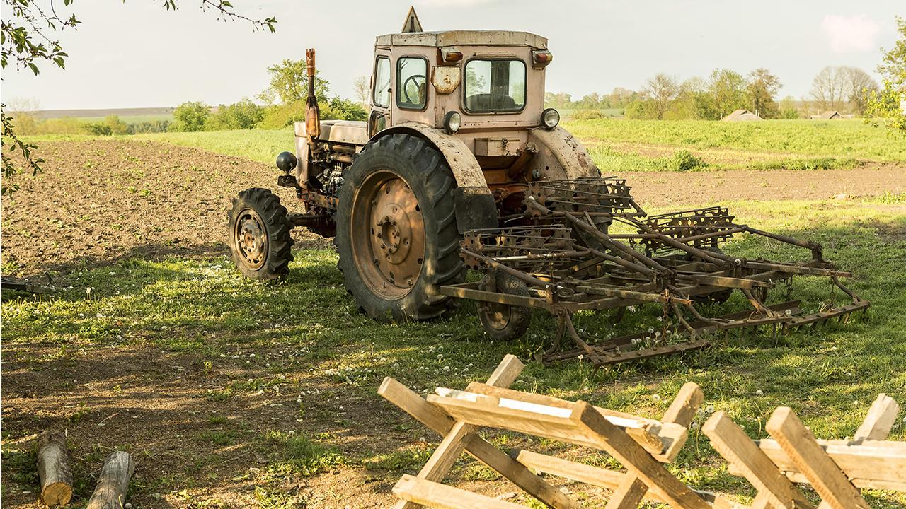
Background

Slide 12
Green house gas - Background
Increasing levels of greenhouse gases in the atmosphere due to human activities are a major driver of climate change. Carbon dioxide(CO2) is the most commonly addressed greenhouse gas, and its atmospheric concentration is measured by parts per million(ppm). Methane(CH4) and nitrous oxide(N2O) are also extraordinarily important for the global climate and are measured by parts per billion (ppb). In 2019, greenhouse gas concentrations reached new highs. Carbon dioxide: 410.5±0.2 ppm = 148% of preindustrial levels Methane: 1877±2 ppb = 260% of preindustrial levels Nitrous oxide: 332.0±0.1 ppb = 123% of pre-industrial levels. It is important to mention that despite setbacks from COVID-19, global greenhouse gas emissions increased in 2020.

Slide 13
Green house gas - Background
After decades of decline, the recent increase in food insecurity is being driven by conflict, economic slowdown, climate variability and extreme weather events. In 2020, over 50 million people were doubly hit – by climate-related disasters (floods, droughts and storms) and by the COVID-19 pandemic. Nearly 690 million people, or 9% of the world population, were undernourished, and about 750 million, or nearly 10%, were exposed to severe levels of food insecurity in 2019. Food insecurity is projected to worsen by 2030

Slide 14
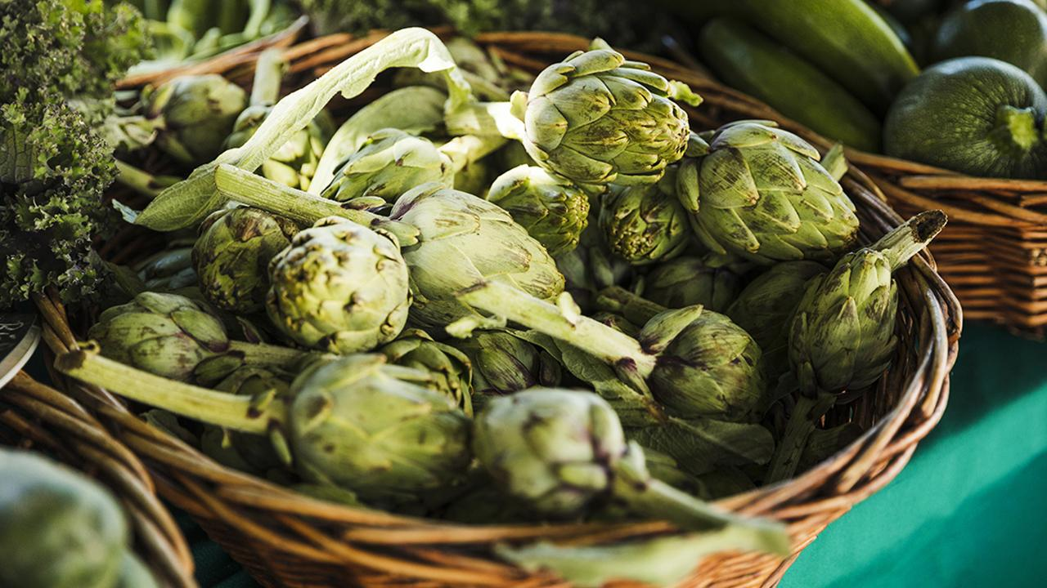
EDA

Slide 15
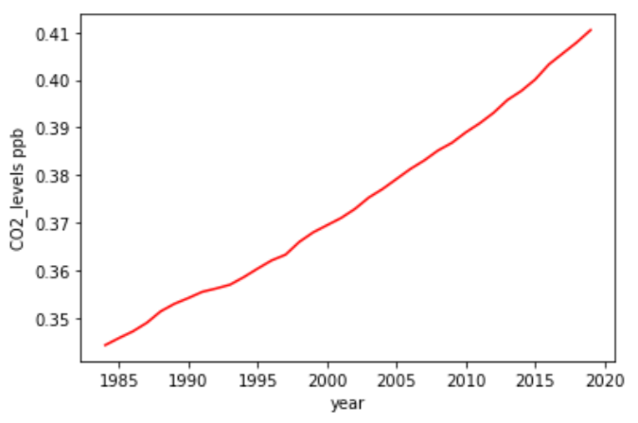
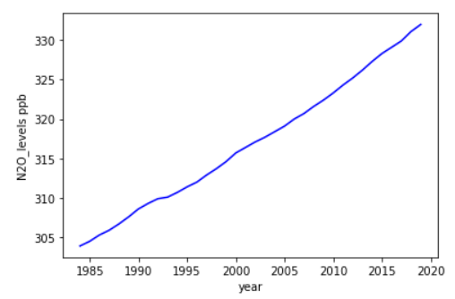
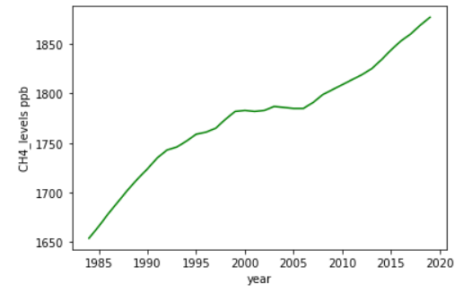
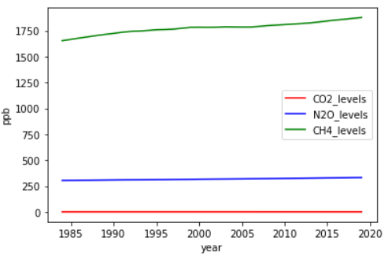
EDA - Green house gas
* We converted the CO2 values to ppb

Slide 16
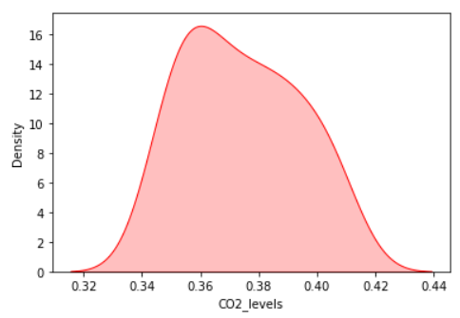
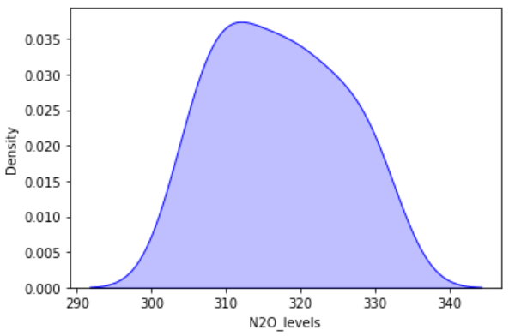
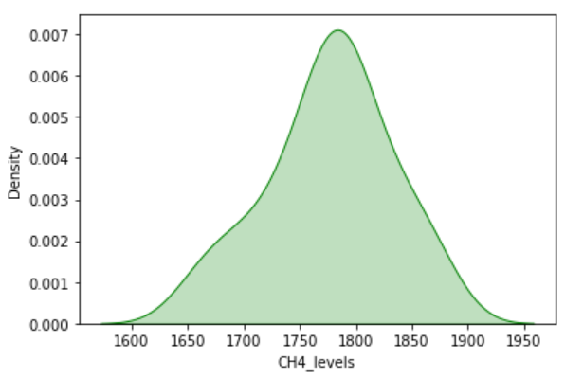
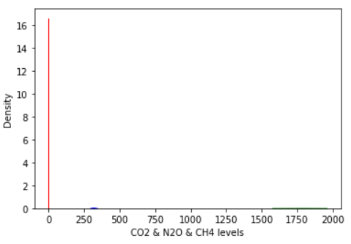
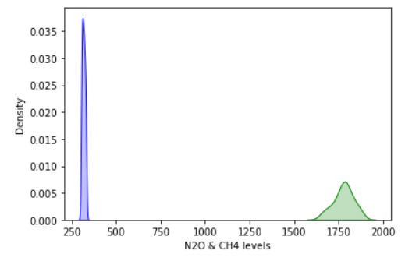
EDA - Green house gas

Slide 17
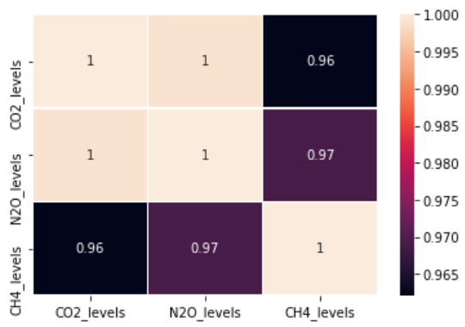
EDA - Green house gas

Slide 18
Crops – Visualization
We visualized the effect of greenhouse gas on the crops along the years 1984-2019 by global growth and by states.
We wanted to see which kind of crop or state was the most or least productid although the gas levels increased
We compared between the amount of production along the years to see the Defranceses between the crops and between the states

Slide 19
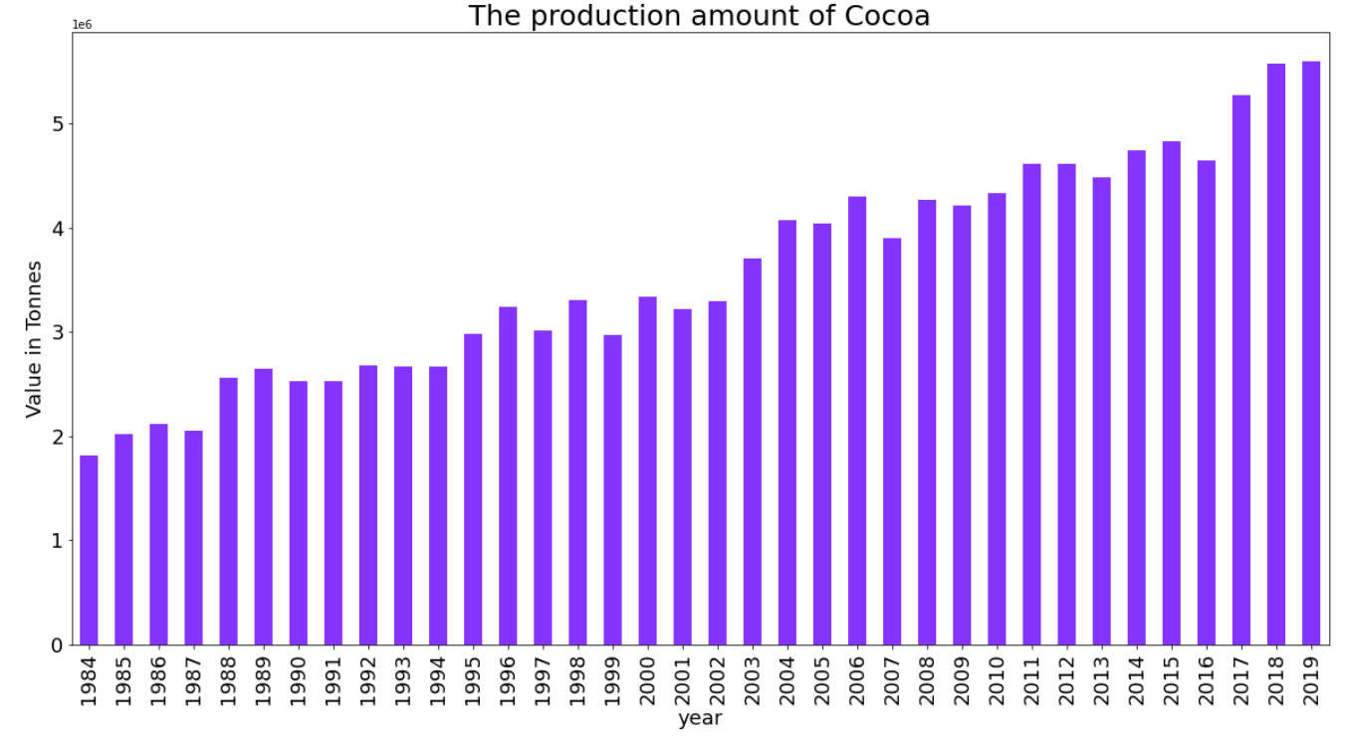
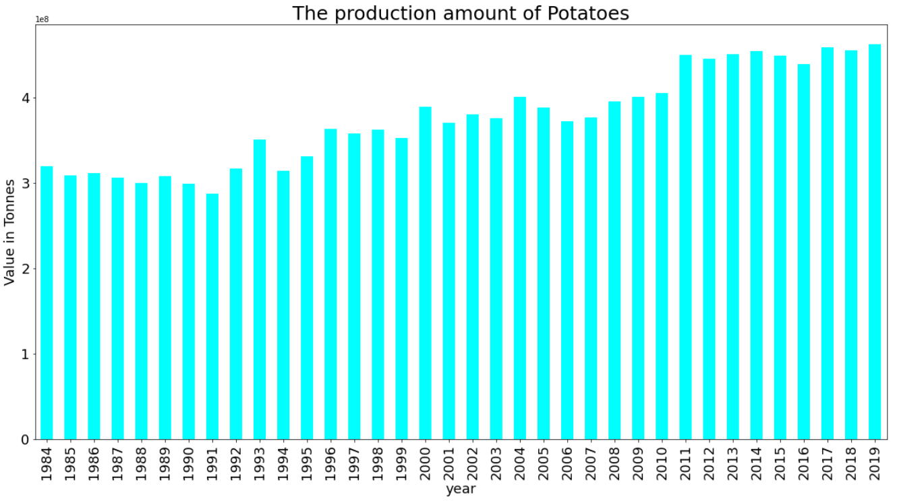
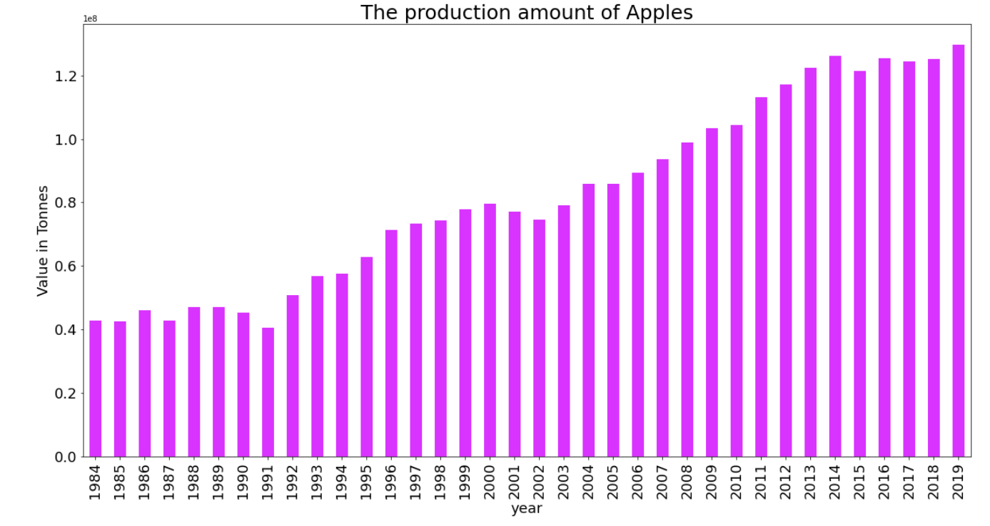
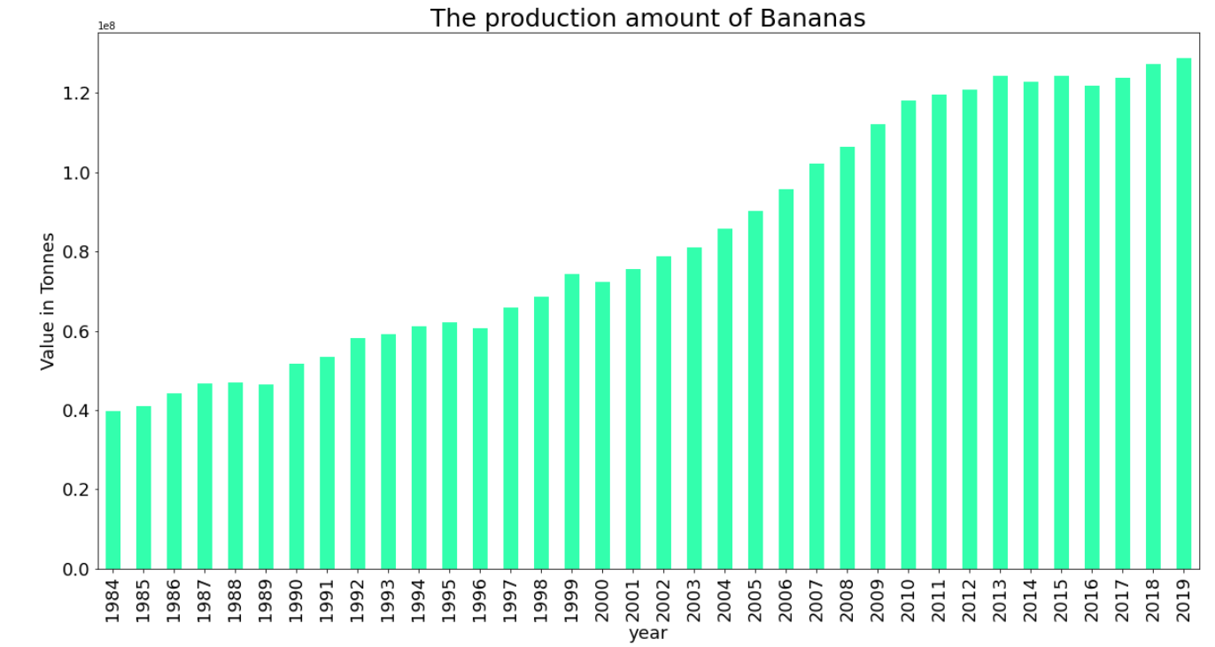
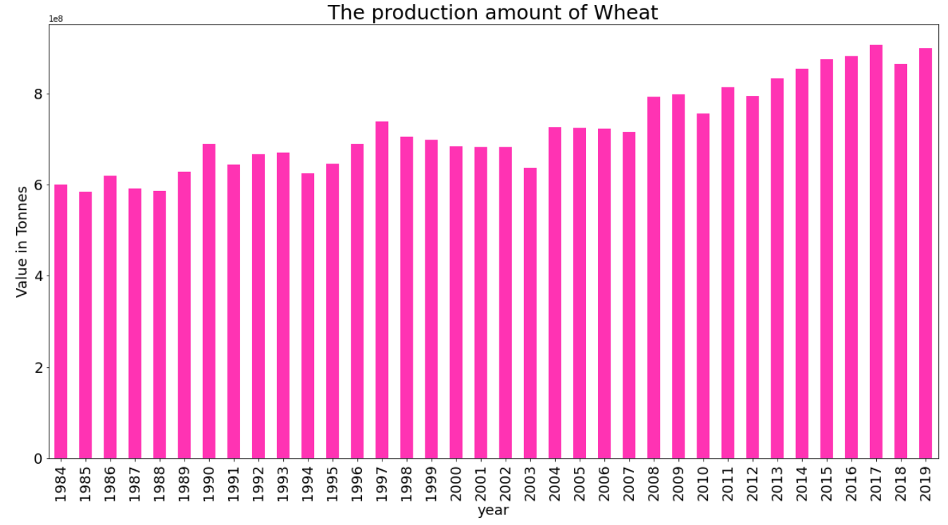
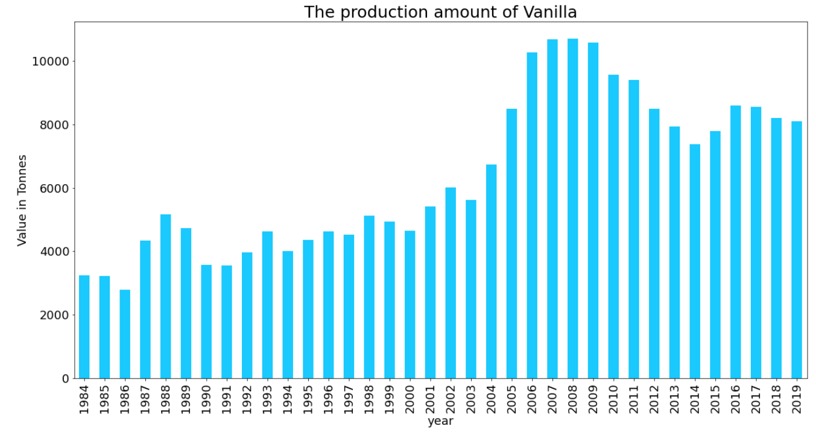
EDA – Different kinds of crops
Apples, Potatoes, Cocoa, Vanilla, Wheat, Bananas

Slide 20
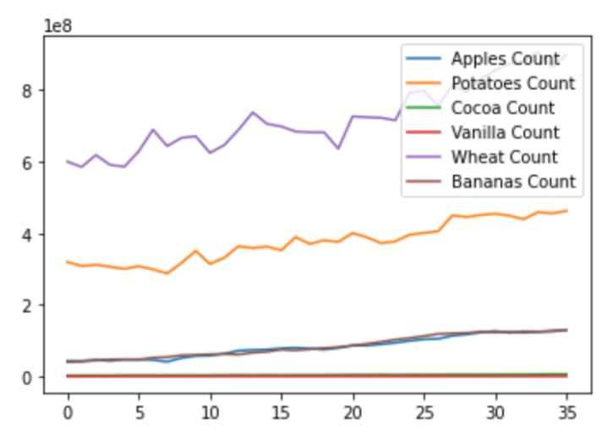
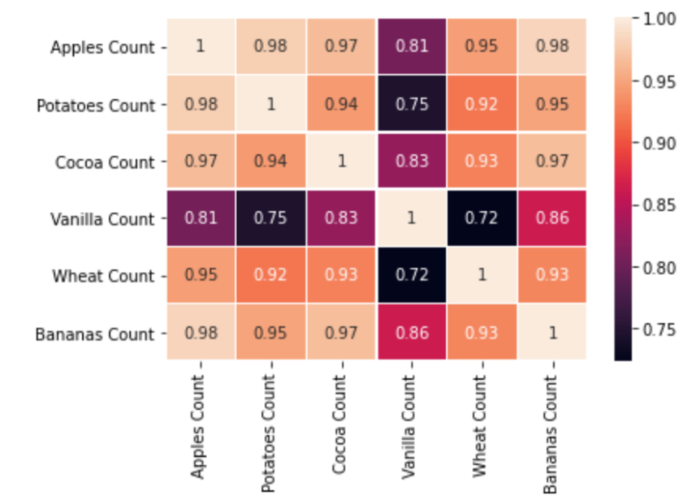
EDA – Different kinds of crops

Slide 21
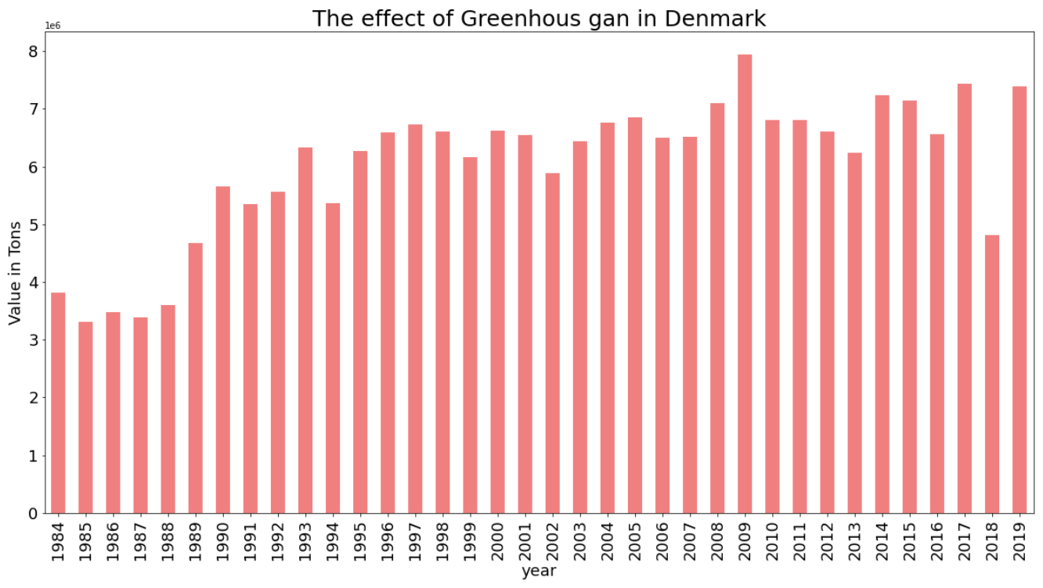
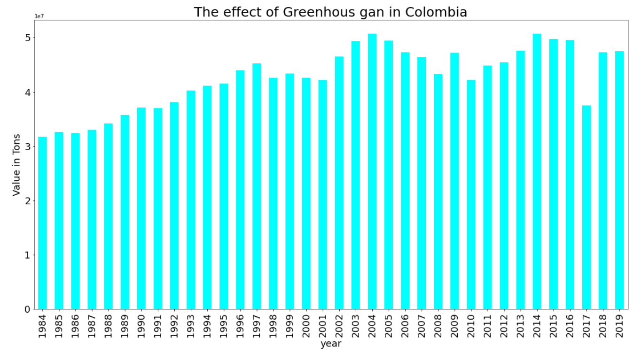
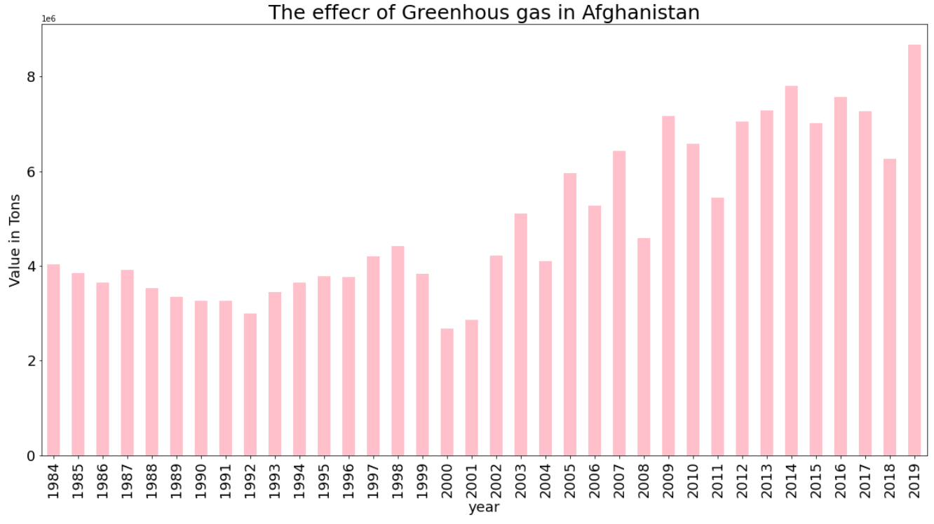
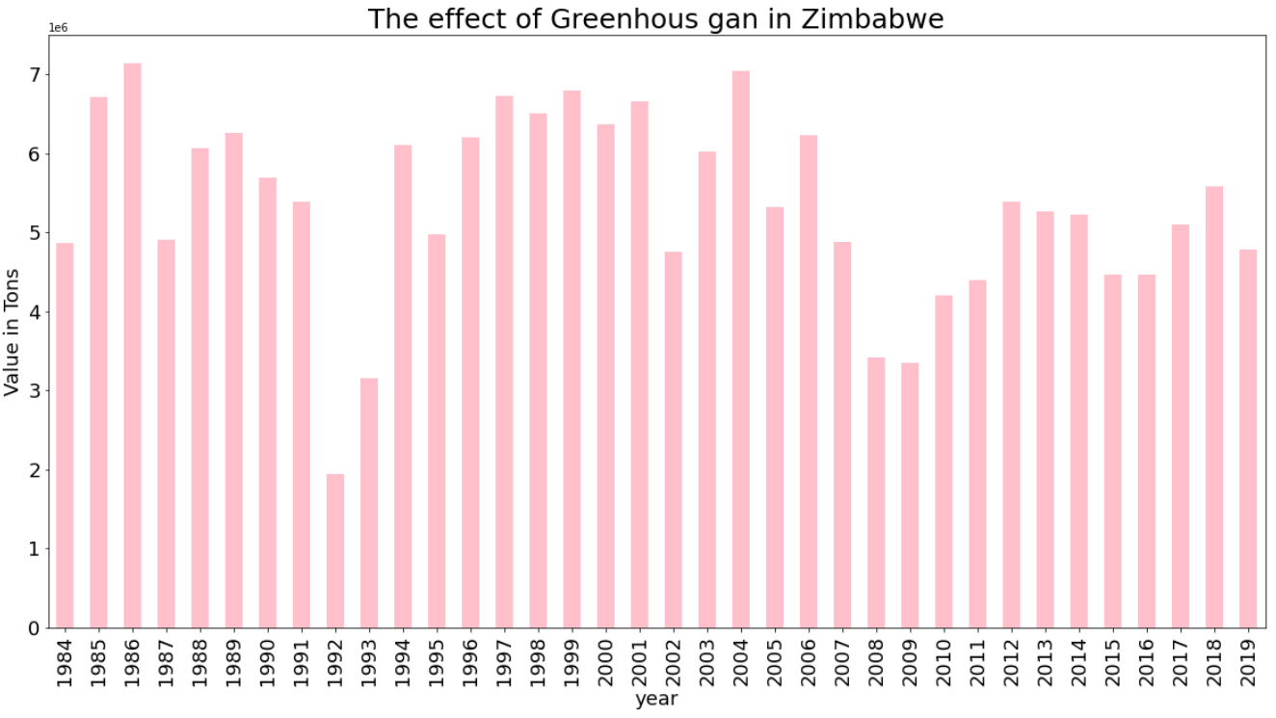
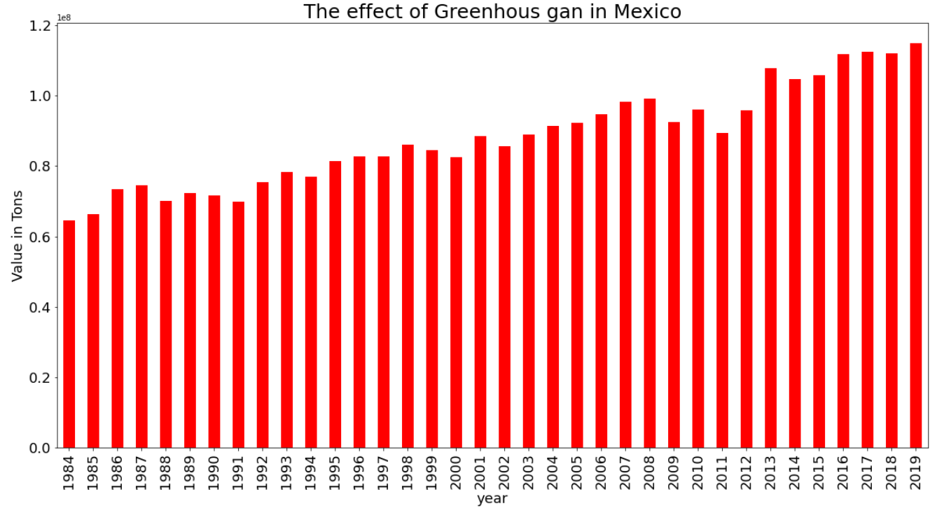
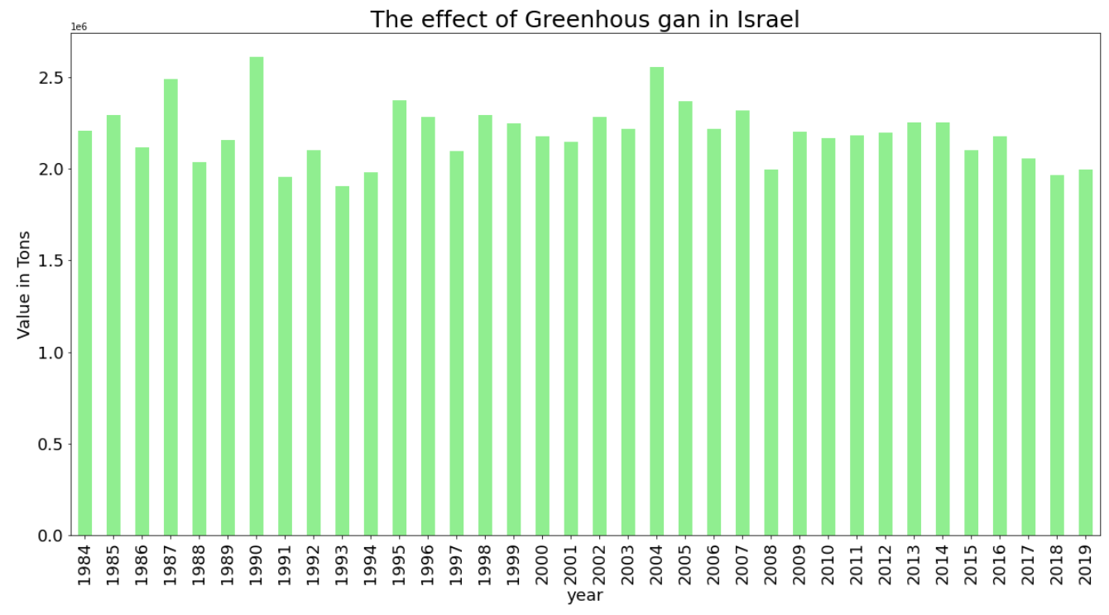
EDA – States
Afghanistan, Colombia, Denmark, Israel, Mexico, Zimbabwe

Slide 22
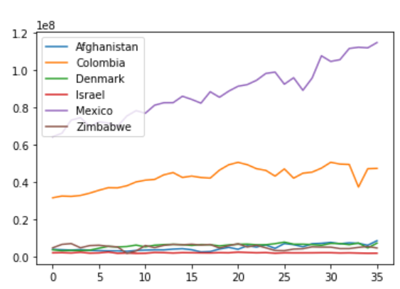

EDA – States

Slide 23
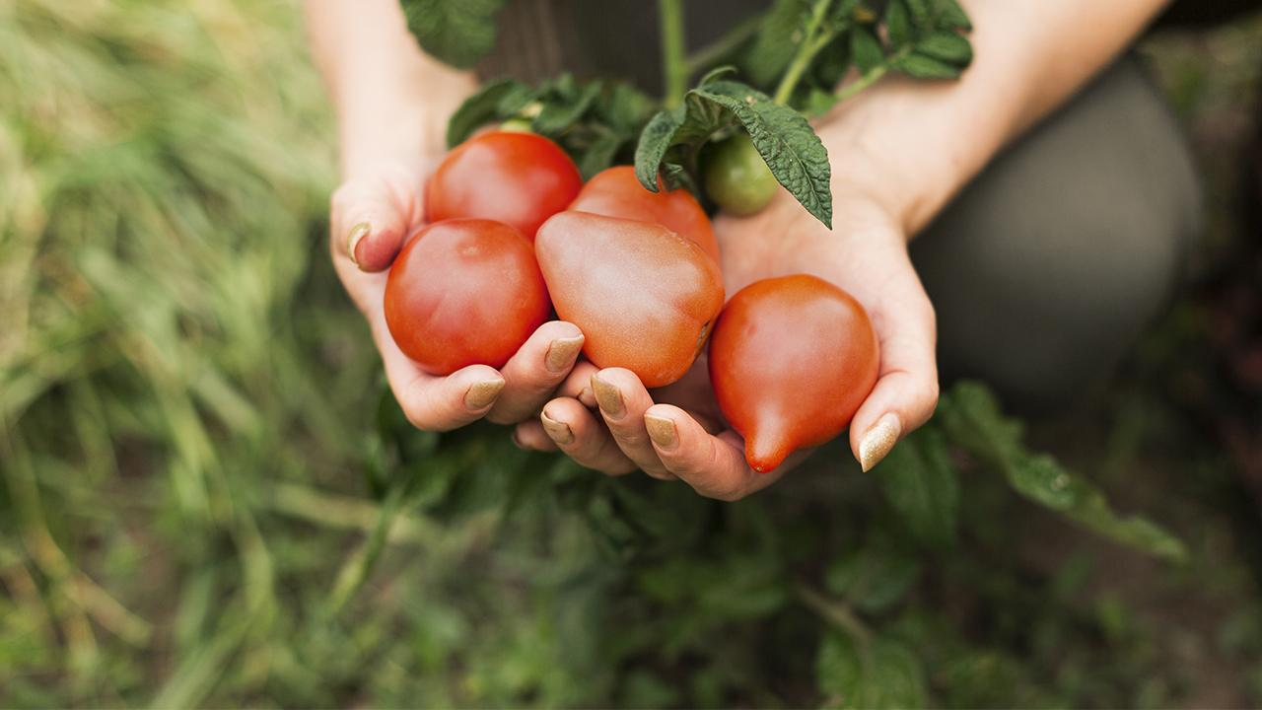
Machine Learning

Slide 24
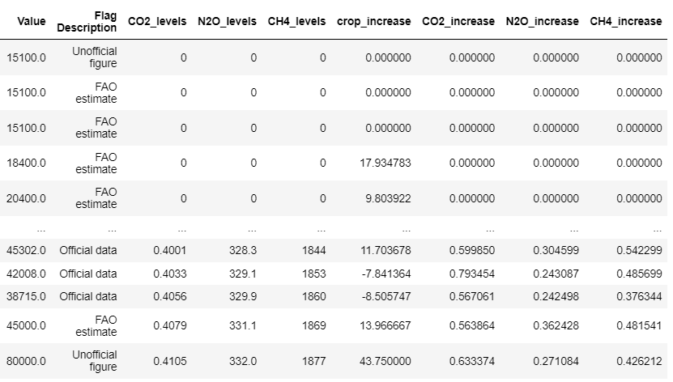
Adding Data
We first added columns indicating an increase or decrease by percentages from the previous year for each CO2_levels, N2O_levels, CH4_levels greenhouse gas. We also added a column indicating an increase or decrease by percentages from the previous year for the Value of crop production to each crop and area. we saved them as 'crop_increase', 'CO2_increase', 'N2O_increase', 'CH4_increase' in the df_Crops_Data data frame.

Slide 25
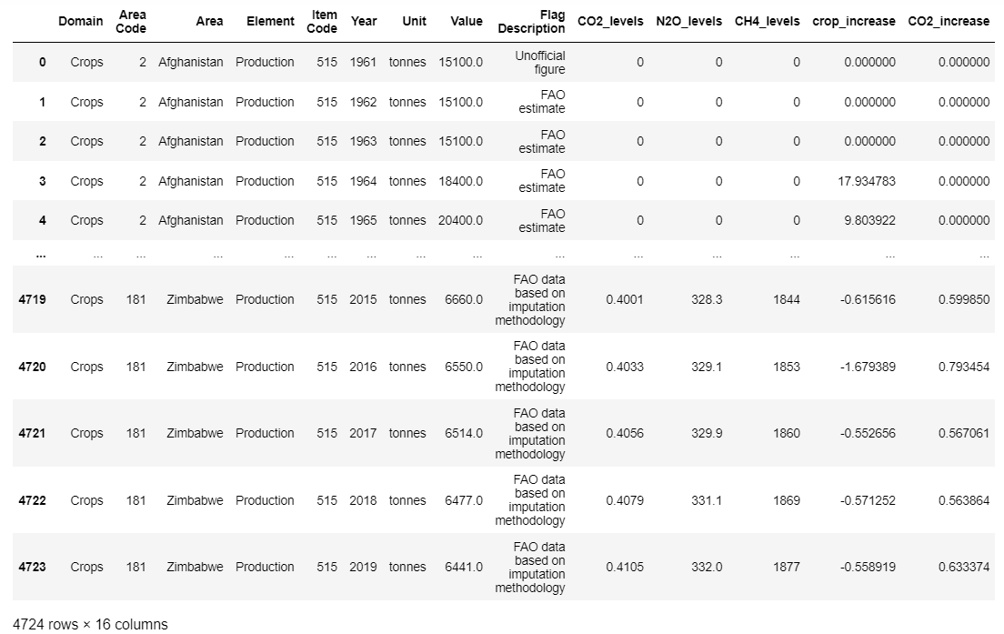
Splitting to one Item - Apples
We decided to focus on one type of crop - Apples, worldwide, in order to do the machine learning on it. We dropped all the rows with other Items, so only Apples will be left in the df_Apples data frame.

Slide 26
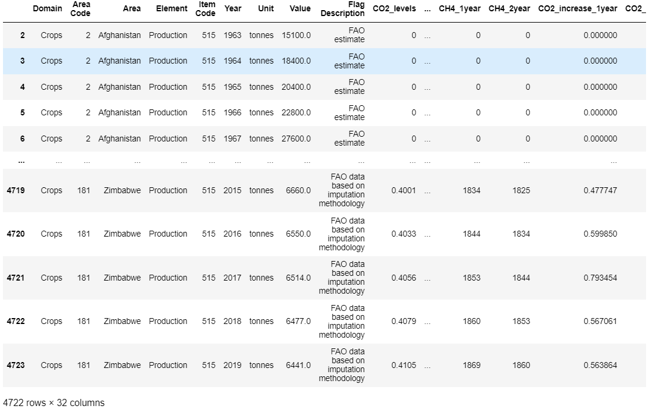
Adding a columns for previous years
We added a columns of the data from the year before and two years before for each - Value, CO2_levels, N2O_levels, CH4_levels, CO2_increase, N2O_increase, CH4_increase, crop_increase. We saved them as 'Value_1year', 'Value_2year', 'CO2_1year', 'CO2_2year', 'N2O_1year', 'N2O_2year', 'CH4_1year', 'CH4_2year', 'CO2_increase_1year', 'CO2_increase_2year', 'N2O_increase_1year', 'N2O_increase_2year', 'CH4_increase_1year','CH4_increase_2year', 'crop_increase_1year', 'crop_increase_2year' in the df_Apples2 data frame. We have 151,104 values in the data farem.

Slide 27
Machine learning - Linear Regression
We wanted to see if we can predict the value for growing Apples according to the data we have in the table.
We sent the 'Value' column to variable y
We sent the following columns to variable X - 'Area Code', 'CO2_levels', 'N2O_levels', 'CH4_levels',
'CO2_increase', 'N2O_increase', 'CH4_increase', 'crop_increase',
'Value_1year', 'Value_2year', 'CO2_1year', 'CO2_2year', 'N2O_1year',
'N2O_2year', 'CH4_1year', 'CH4_2year', 'CO2_increase_1year','CO2_increase_2year', 'N2O_increase_1year', 'N2O_increase_2year',
'CH4_increase_1year', 'CH4_increase_2year', 'crop_increase_1year', 'crop_increase_2year'.
Total 113,328 variables to X

Slide 28
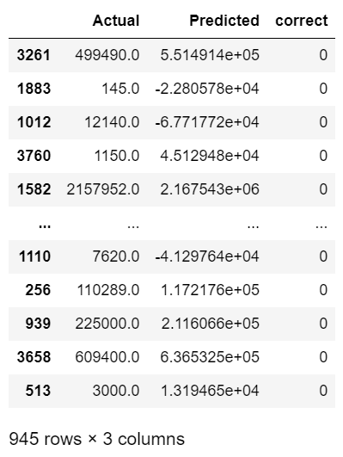
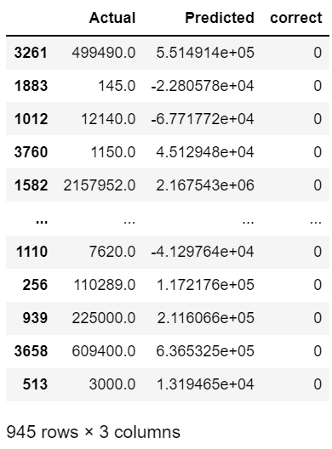
Machine learning - Linear Regression
We tried to use the 'StandardScaler()' and the 'MinMaxScaler()'
Standard Scaler:
Min Max Scaler:
We didn't get the results we wanted to see although we got r^2: 0.9874470776357982 at this model which means it is accuret

Slide 29
Machine learning - Logistic Regression
We didn't get good results in the linear regression so we tried logistic regression and use the 'StandardScaler()' and the 'MinMaxScaler()'
Standard Scaler:
r^2: 0.9563237023294495
accuracy: 0.0
precision: 0.0
recall: 0.0
f1: 0.0
Min Max Scaler:
r^2: 0.9563237023294495
accuracy: 0.0021164021164021165
precision: 0.0021164021164021165
recall: 0.0021164021164021165
f1: 0.0021164021164021165
The results are a little bit better, especially in the 'MinMaxScaler()'

Slide 30
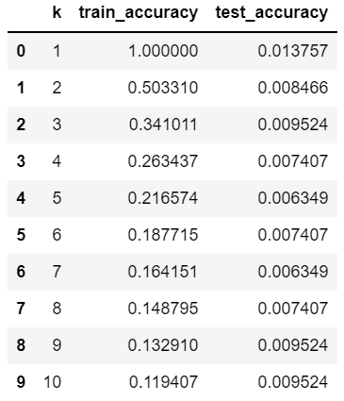
Machine learning - KNN
We also tried to use KNN
Testing values of k (range of 1 to 10) to see what value/range performs best and what is the accuracy on train and test
KNN results:
r^2: 0.9563237023294495
accuracy: 0.004232804232804233
precision: 0.0021516754850088183
recall: 0.004232804232804233
f1: 0.0026455026455026454
The results are even more better but still not enough

Slide 31

Conclusions

Slide 32
Conclusions
Prediction
Effect
We were unable to predict the production value of Apples, probably because there are other variables that affect the production output of each state besides greenhouse gas levels, such as the size of the state and its economic situation.
Biased on the results we got from the machine learning we can say that the Greenhouse gas doesn't have a lot of effect on crop production around the world

Slide 33
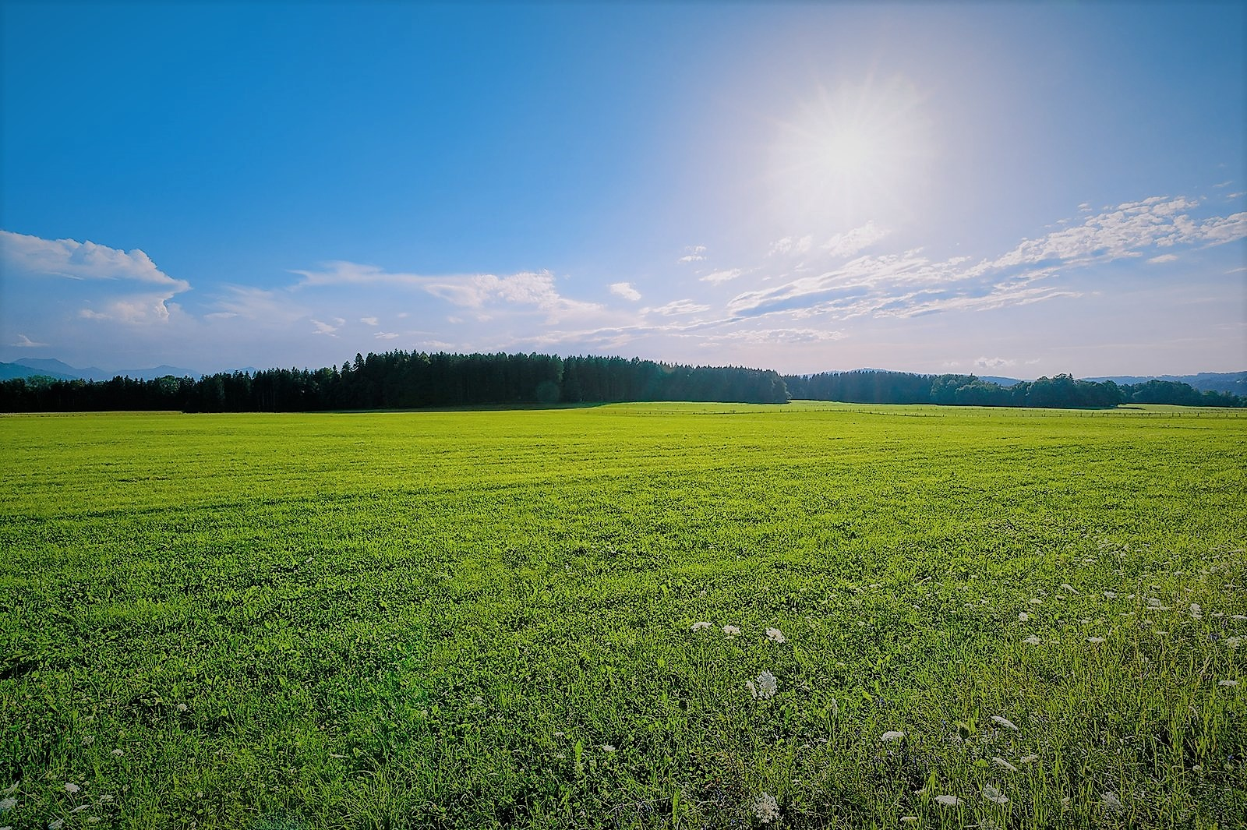
Thank you!

